Slide 1

Proposal to use bit.dev

Slide 2

Why bit.dev, why not storybook + npm?

Slide 3
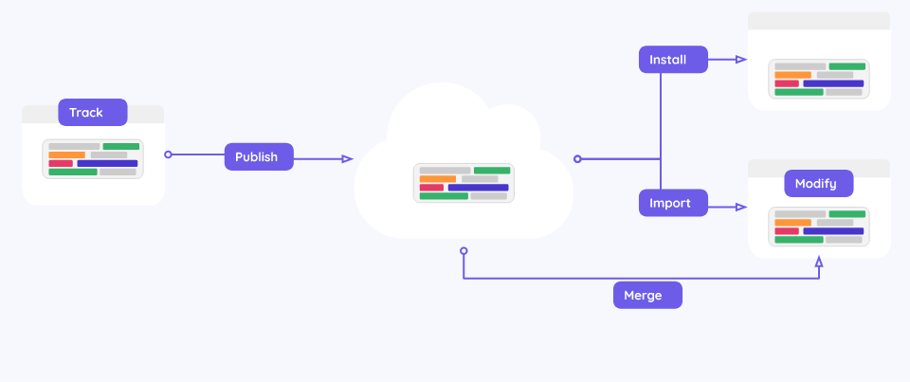
Sharing reusable components is made easy.

Slide 4
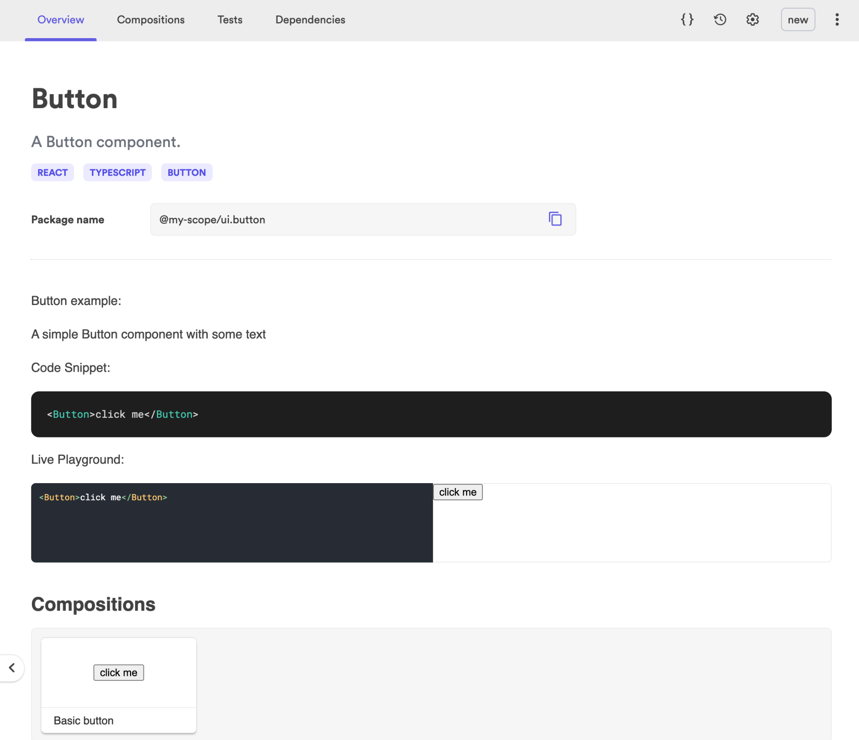
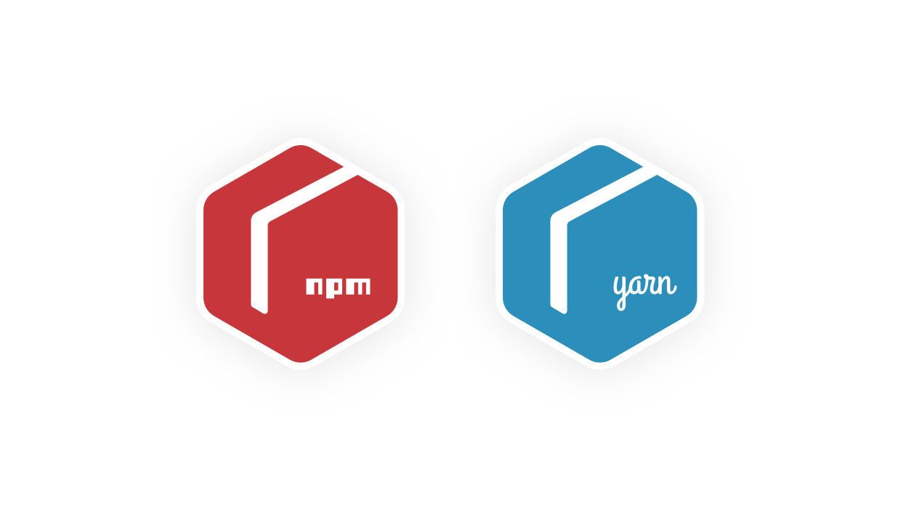
Packed NPM & yarn with rich components view

Slide 5
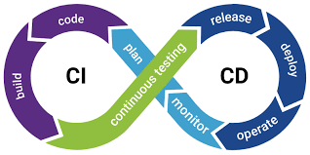
Automated CI/CD

Slide 6
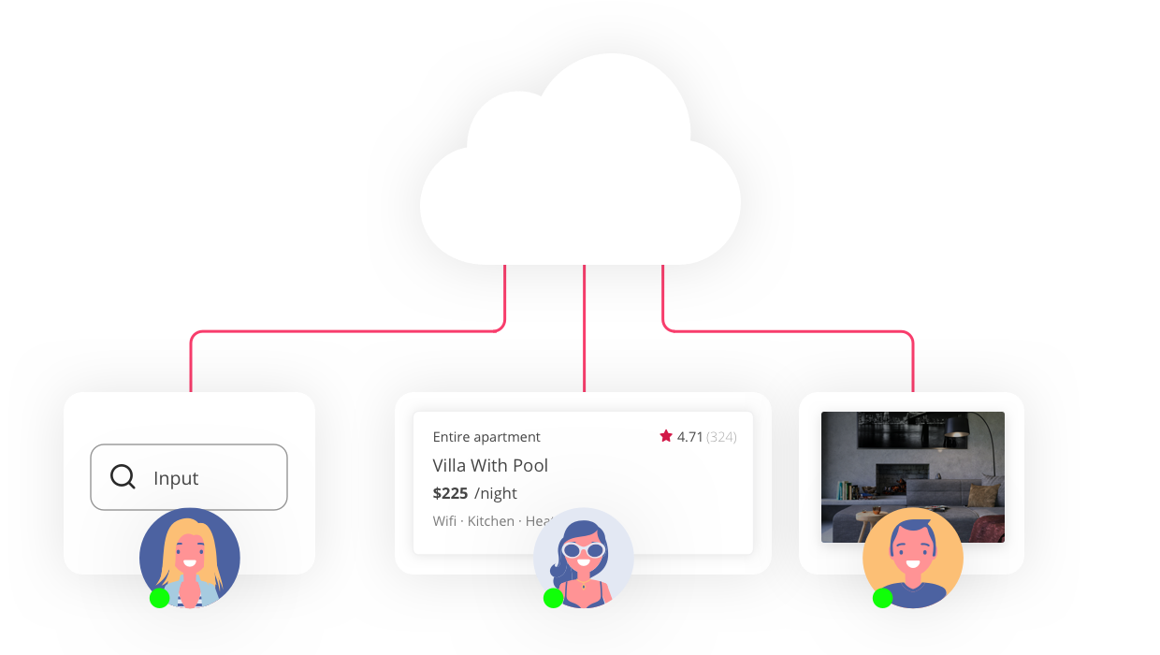
Receive and contribute to community

Slide 7
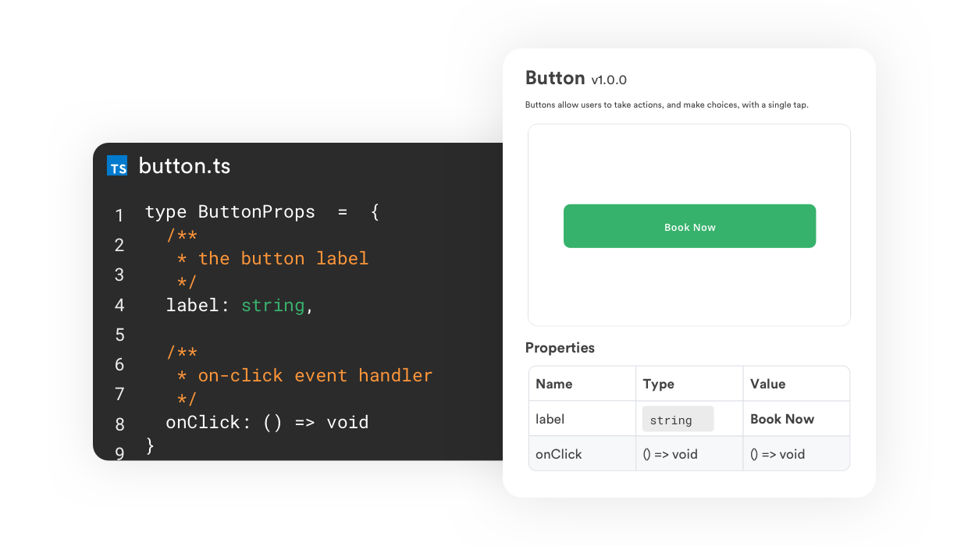
Easy documentation

Slide 8
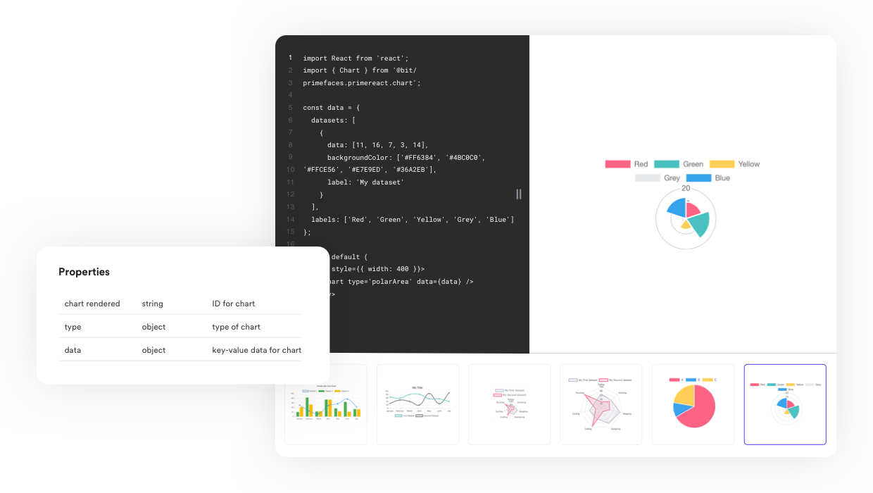
Play with examples hands-on

Slide 9
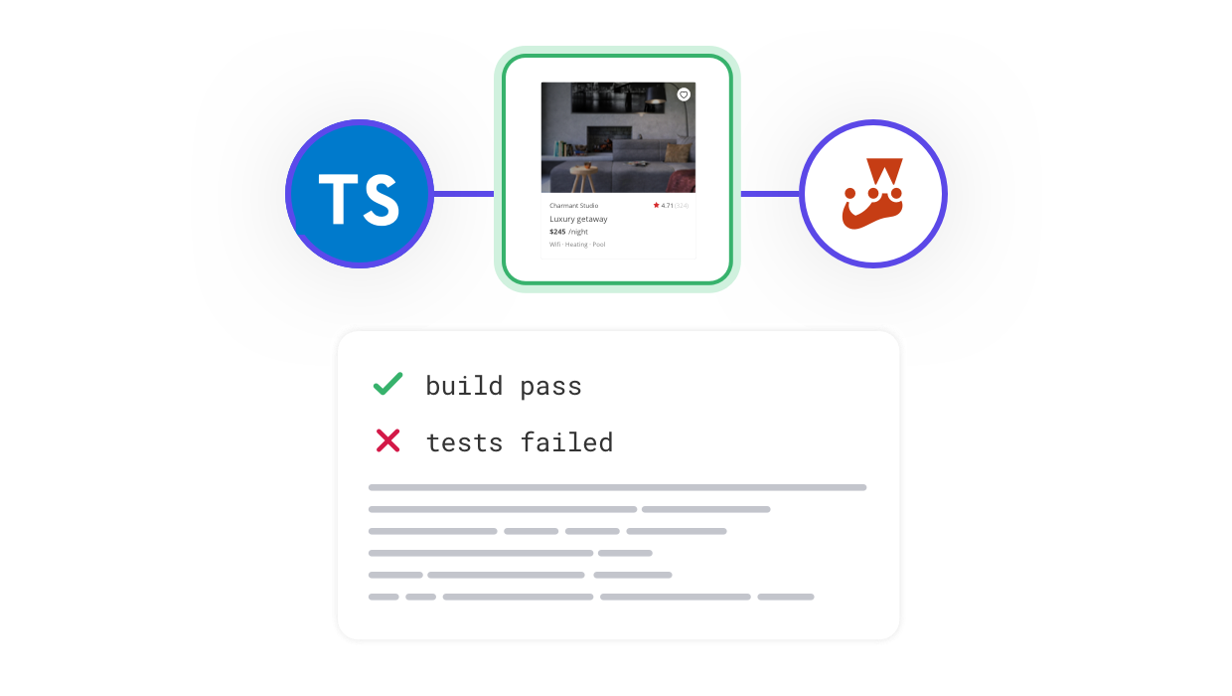
Build and test all impacted components

Slide 10
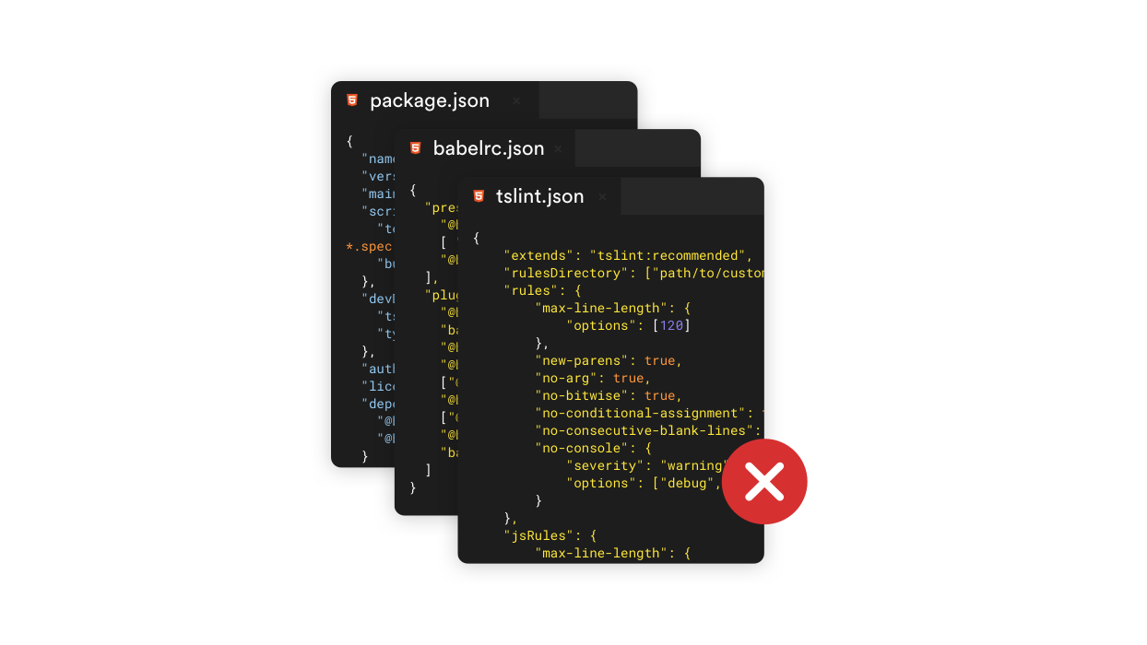
Enjoy an effortless, scalable monorepo dev experience

Slide 11
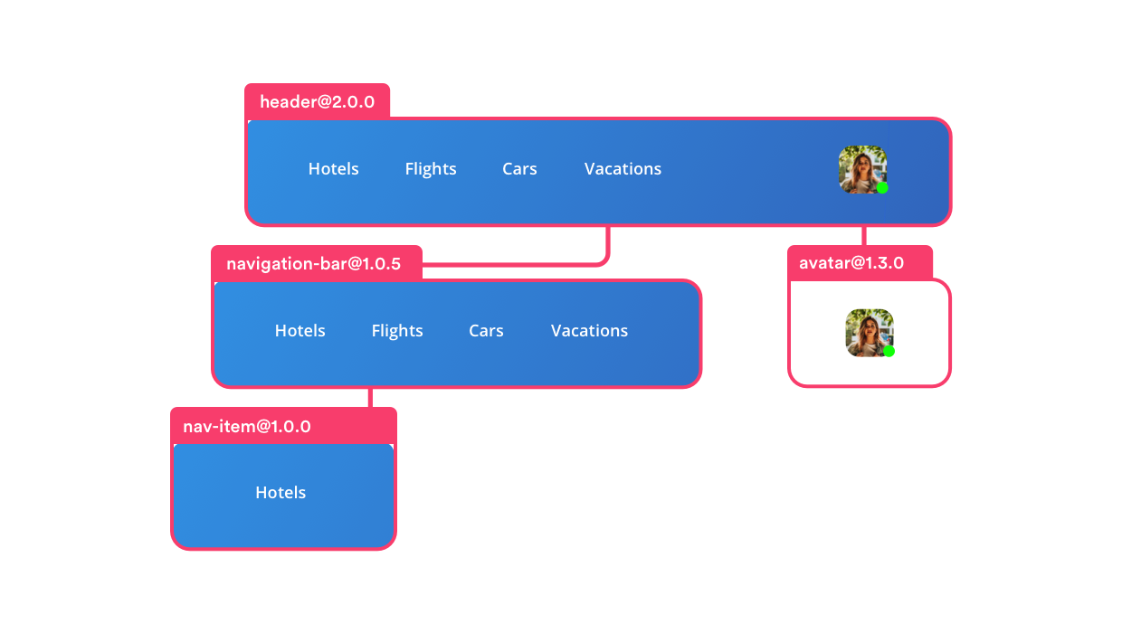
Easily version components and update dependencies

Slide 12
Standardize development across teams and projects

Slide 13
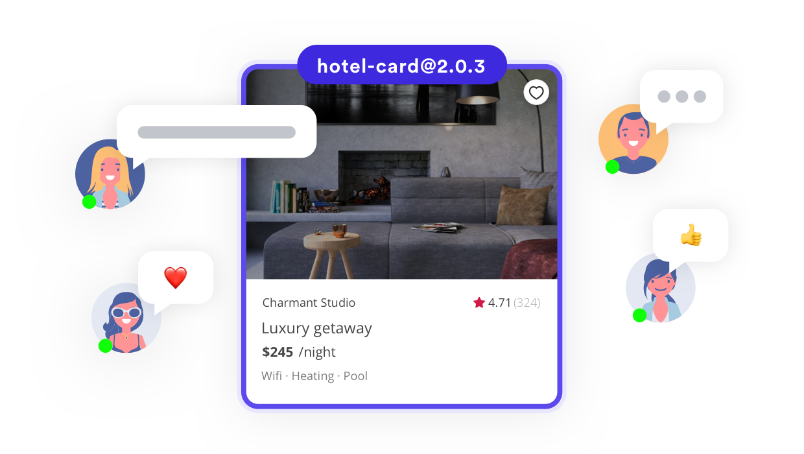
Drive collaboration and adoption for components

Slide 14
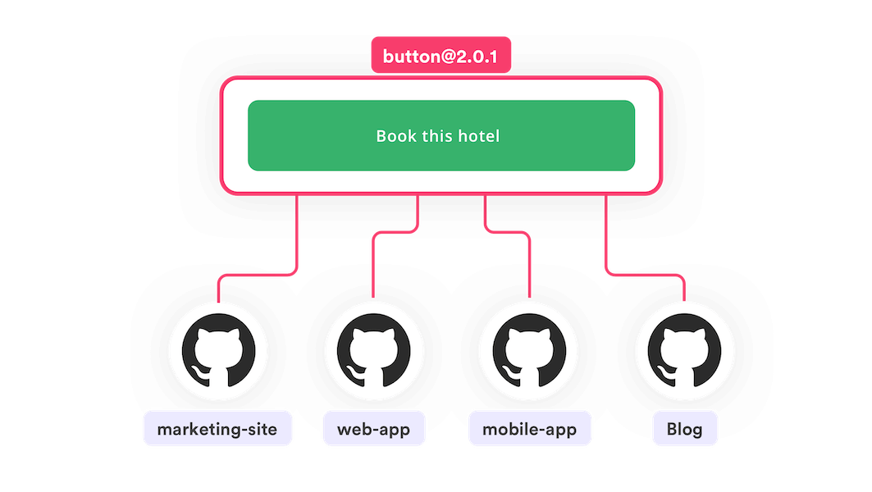
Automatically create PRs to impacted GitHub projects

Slide 15
Thank You

